Slide 1
Chapter 18
How to use JavaScript to enhance your web pages

Slide 2
Objectives
Applied
Given an HTML document, use JavaScript to enhance the page so it includes the current date, current year, or a Print button.
Given an HTML document and tested JavaScript code, use the code to enhance a web page so it includes an image swap or slide show.
Use the Internet to find tested JavaScript and jQuery code that you can use to enhance a web page.
Knowledge
Describe how JavaScript works.
Describe the Document Object Model (DOM) and explain what happens when DOM scripting is used to change the DOM.
In general terms, describe how you script the DOM and how the $ sign is commonly used for DOM scripting.

Slide 3
Objectives (continued)
Describe the way that JavaScript event handlers work with DOM scripting.
Describe jQuery and the two ways you can include it in a web page.
Describe the syntax for calling jQuery methods, including the use of the $ sign, selectors, and the dot operator.
Describe the syntax for coding a jQuery event handler, including the use of an event method and function.
Describe the use of the jQuery ready method.
In general terms, describe how you use jQuery for functions like image swaps and slide shows.

Slide 4
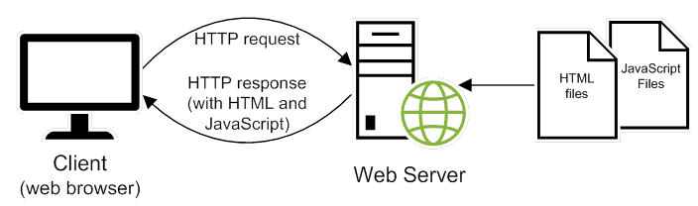
How JavaScript fits into the client/server architecture

Slide 5
JavaScript that gets the current date and year
<p>
<script>
var today = new Date();
document.write("Current date: ");
document.write(today.toDateString());
</script>
</p>
<p>
<script>
var today = new Date();
document.write("&copy;&nbsp;");
document.write(today.getFullYear());
document.write(", San Joaquin Valley Town Hall")
</script>
</p>

Slide 6
The JavaScript for current date and year in a web browser

Slide 7
A script element in the head section that loads an external JavaScript file
<script src="set_date.js"></script>

Slide 8
JavaScript embedded in the head section
<head>
...
<script>
var $ = function (id) {
return document.getElementById(id);
}
window.onload = function() {
var today = new Date();
$("date").firstChild.nodeValue =
"Current date: " + today.toDateString();
}
</script>
</head>

Slide 9
JavaScript embedded in the body
<p>
<script>
var today = new Date();
document.write("Current date: ");
document.write(today.toDateString());
</script>
</p>

Slide 10
The code for a web page
<!DOCTYPE html>
<html>
<head>
<title>Join Email List</title>
</head>
<body>
<h1>Please join our email list</h1>
<form id="email_form" name="email_form"
action="join.html" method="get">
<label for="email_address">Email Address:</label>
<input type="text" id="email_address">
<span id="email_error">*</span>
</form>
</body>
</html>

Slide 11
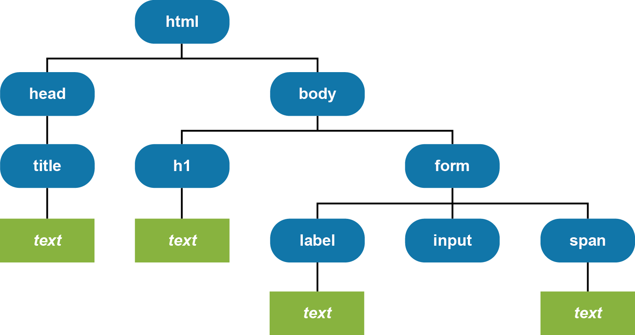
The DOM for the web page

Slide 12
DOM nodes commonly used in DOM scripting
Element
Attr
Text

Slide 13
The document object
Methods of the document object
getElementById(id)
write(string)
Examples of document methods
// returns the object for the HTML element
var rateBox = document.getElementById("rate");
// writes a string into the document
document.write("Today is " + today.toDateString());
A standard $ function that gets the object for an element by using its id
var $ = function (id) {
return document.getElementById(id);
}

Slide 14
Scripting the DOM
Three properties for scripting the DOM
value
firstChild
nodeValue
How to get the text of an HTML element
var emailAddress = $("email_address").value;
How to set the text of an HTML element
$("email_error").firstChild.nodeValue = "Entry is invalid.";

Slide 15
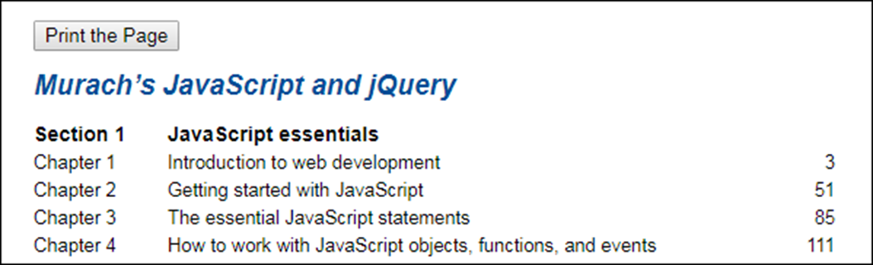
A page that uses a JavaScript button for printing

Slide 16
The JavaScript in an external printPage.js file
var $ = function (id) {
// this function returns the object for the element
return document.getElementById(id);
}
var printPage = function() {
// this is the event handler
// for the click event of the button
window.print();
}
window.onload = function() {
// this is the event handler for the onload event
$("printButton").onclick = printPage;
}
HTML that includes the JavaScript file
<script src="printPage.js"></script>
HTML for the Print the Page button
<input type="button" id="printButton"
value="Print the Page">

Slide 17
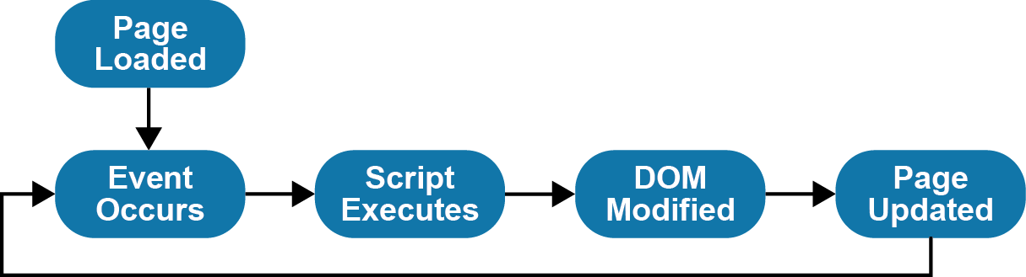
The DOM event cycle

Slide 18
The Email List with JavaScript for data validation

Slide 19
The HTML file for the Email List application
<!DOCTYPE html>
<html>
<head>
<meta charset="UTF-8">
<title>Join Email List</title>
<link rel="stylesheet" href="email_list.css">
<script src="email_list.js"></script>
</head>
<body>
<main>
<h1>Please join our email list</h1>
<form id="email_form" name="email_form"
action="join.html" method="get">
<label for="email_address1">
Email Address:</label>
<input type="text" id="email_address1"
name="email_address1">
<span id="email_address1_error">*</span><br>

Slide 20
The HTML file for the Email List app (continued)
<label for="email_address2">
Re-enter Email Address:</label>
<input type="text" id="email_address2"
name="email_address2">
<span id="email_address2_error">*</span><br>
<label for="first_name">First Name</label>
<input type="text" id="first_name"
name="first_name">
<span id="first_name_error">*</span><br>
<label>&nbsp;</label>
<input type="button" id="join_list"
value="Join our List">
</form>
</main>
</body>
</html>

Slide 21
The code for the JavaScript file (email_list.js)
var $ = function (id) {
return document.getElementById(id);
}
var joinList = function () {
var emailAddress1 = $("email_address1").value;
var emailAddress2 = $("email_address2").value;
var isValid = true;
if (emailAddress1 == "") {
$("email_address1_error").firstChild.nodeValue =
"This field is required.";
isValid = false;
}
else {
$("email_address1_error").firstChild.nodeValue =
""; }

Slide 22
The code for the email_list.js file (continued)
if (emailAddress1 !== emailAddress2) {
$("email_address2_error").firstChild.nodeValue =
"This entry must equal first entry.";
isValid = false;
}
else {
$("email_address2_error").firstChild.nodeValue =
""; }
...
if (isValid) {
// submit the form if all entries are valid
$("email_form").submit();
}
}
window.onload = function () {
$("join_list").onclick = joinList;
}

Slide 23
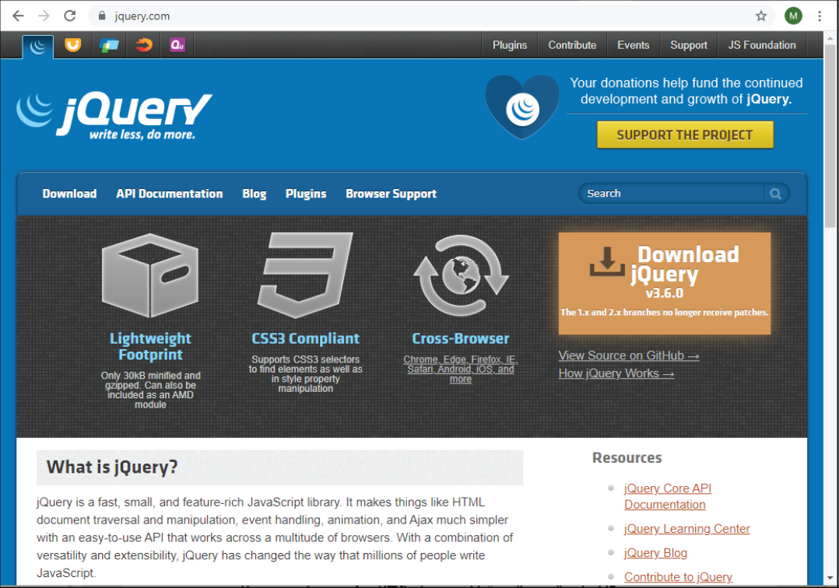
The jQuery website at jQuery.com

Slide 24
What jQuery offers
Dozens of methods that make it easier to add JavaScript features to your web pages
Methods that are tested for cross-browser compatibility

Slide 25
How to include jQuery files in a web page
How to include the jQuery file from your computer
<script src="jquery-3.6.0.js"></script>
How to include jQuery from a CDN
<script src="http://code.jquery.com/jquery-3.6.0.min.js">
</script>

Slide 26
How to code jQuery selectors
By element type
$("h2")
By id
$("#email_address")
By class attribute
$(".warning")

Slide 27
How to call jQuery methods
How to get the value from a text box
var emailAddress = $("#email_address").val();
How to set the text in an element
$("#email_address_error").text(
"Email address is required");
How to set the text for the next sibling
$("#email_address").next().text(
"Email address is required");

Slide 28
How to code jQuery event methods
How to code the ready event method
$(document).ready(function() {
alert("The DOM is ready");
});
How to code the click event method for all h2 elements
$("h2").click(function() {
alert("This heading has been clicked");
});
How to use the click event method within the ready event method
$(document).ready(function() {
$("h2").click(function() {
alert("This heading has been clicked");
}); // end of click event handler
}); // end of ready event handler

Slide 29
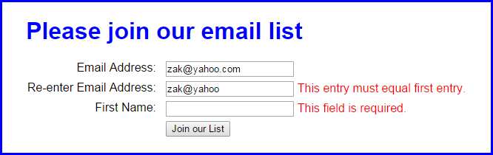
The Email List application using jQuery

Slide 30
The HTML for the Email List with jQuery app
<!DOCTYPE html>
<html>
<head>
<meta charset="UTF-8">
<title>Join Email List</title>
<link rel="stylesheet" href="email_list.css">
<script
src="http://code.jquery.com/jquery-3.6.0.min.js">
</script>
<script src="email_list.js"></script>
</head>
<body>
<main>
<h1>Please join our email list</h1>
<form id="email_form" name="email_form"
action="join.html" method="get">
<label for="email_address1">
Email Address:</label>
<input type="text" id="email_address1"
name="email_address1">
<span>*</span><br>

Slide 31
The HTML for the Email List jQuery app (cont.)
<label for="email_address2">
Re-enter Email Address:</label>
<input type="text" id="email_address2"
name="email_address2">
<span>*</span><br>
<label for="first_name">First Name:</label>
<input type="text" id="first_name"
name="first_name">
<span>*</span><br>
<label>&nbsp;</label>
<input type="button" id="join_list"
value="Join our List">
</form>
</main>
</body>
</html>

Slide 32
The jQuery for the Email List application (part 1)
$(document).ready(function() {
$("#join_list").click(function() {
var emailAddress1 = $("#email_address1").val();
var emailAddress2 = $("#email_address2").val();
var isValid = true;
// validate the first email address
if (emailAddress1 == "") {
$("#email_address1").next().text(
"This field is required.");
isValid = false;
}
else {
$("#email_address1").next().text("");
}

Slide 33
The jQuery for the Email List application (part 2)
// validate the second email address
if (emailAddress2 == "") {
$("#email_address2").next().text(
"This field is required.");
isValid = false;
}
else if (emailAddress1 != emailAddress2) {
$("#email_address2").next().text(
"This entry must equal first entry.");
isValid = false;
}
else {
$("#email_address2").next().text("");
}

Slide 34
The jQuery for the Email List application (part 3)
// validate the first name entry
if ($("#first_name").val() == "") {
$("#first_name").next().text(
"This field is required.");
isValid = false;
}
else {
$("#first_name").next().text("");
}
// submit the form if all entries are valid
if (isValid) {
$("#email_form").submit();
}
}); // end click
}); // end ready

Slide 35
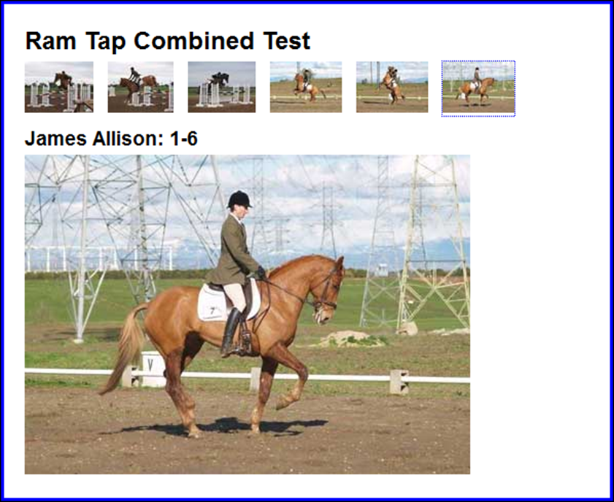
The user interface for the Image Swap application

Slide 36
The script elements for the image swap
<script src="jquery-3.6.0.min.js"></script>
<script src="image_swaps.js"></script>

Slide 37
The HTML for the images
<main>
<h1>Ram Tap Combined Test</h1>
<ul id="image_list">
<li><a href="images/h1.jpg"
title="James Allison: 1-1">
<img src="thumbnails/t1.jpg" alt=""></a></li>
<li><a href="images/h2.jpg"
title="James Allison: 1-2">
<img src="thumbnails/t2.jpg" alt=""></a></li>
...
<li><a href="images/h6.jpg"
title="James Allison: 1-6">
<img src="thumbnails/t6.jpg" alt=""></a></li>
</ul>
<h2 id="caption">James Allison 1-1</h2>
<p><img src="images/h1.jpg" alt="" id="image"></p>
</main>

Slide 38
The CSS for the li elements
li {padding-right: 10px; display: inline; }

Slide 39

A Slide Show application with fading out and in

Slide 40
The script elements for the slide show
<script src="jquery-3.6.0.min.js"></script>
<script src="slide_show.js"></script>

Slide 41
The HTML for the slide show
<section>
<h1>Fishing Slide Show</h1>
<h2 id="caption">Casting on the Upper Kings</h2>
<img id="slide" src="images/casting1.jpg" alt="">
<div id="slides">
<img src="images/casting1.jpg"
alt="Casting on the Upper Kings">
<img src="images/casting2.jpg"
alt="Casting on the Lower Kings">
<img src="images/catchrelease.jpg"
alt="Catch and Release on the Big Horn">
<img src="images/fish.jpg"
alt="Catching on the South Fork">
<img src="images/lures.jpg"
alt="The Lures for Catching">
</div>
</section>

Slide 42
The critical CSS for the slide show
#slides img { display: none; }

Slide 43
Two websites for JavaScript and jQuery code
Dynamic Drive
The JavaScript Source
Two types of jQuery components that you can add to your website
jQuery plugins
jQuery UI widgets

Slide 44
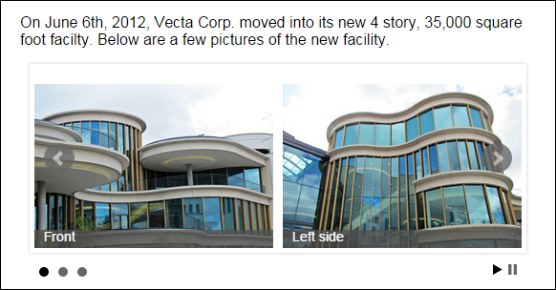
A jQuery plugin for a carousel called bxSlider

Slide 45
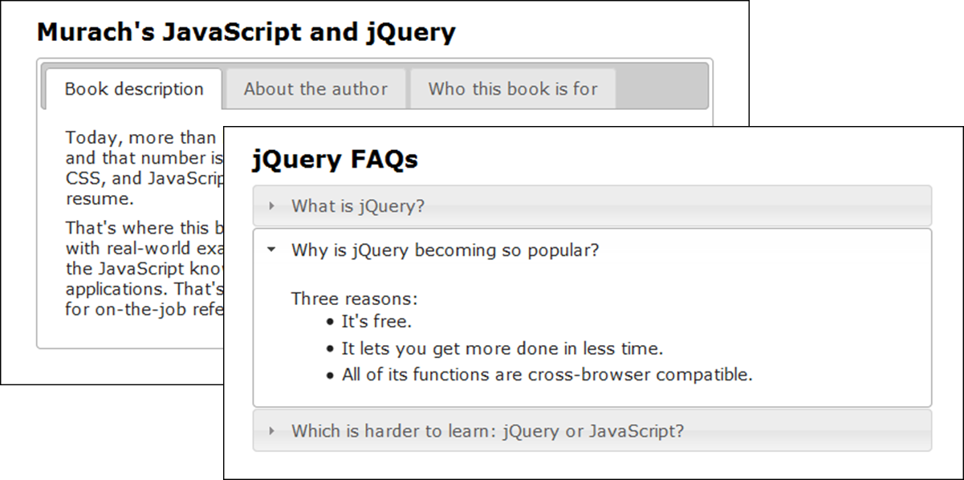
jQuery UI widgets for tabs and accordions

Slide 46
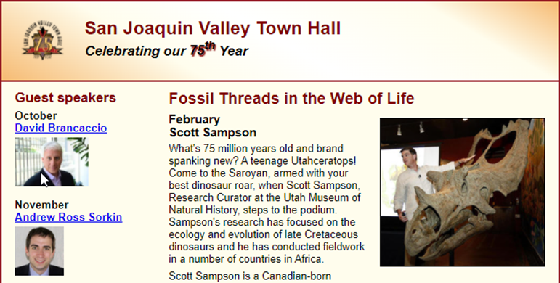
Short 18-1 Do image rollovers using jQuery

